Slide 1
Checks & Balances

Slide 2
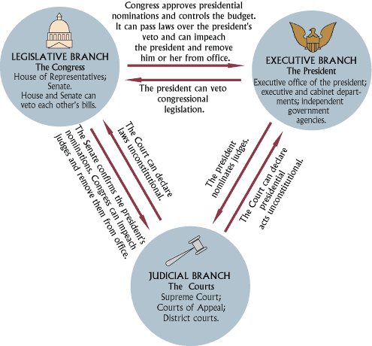

Slide 3
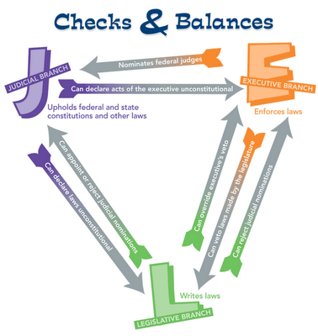

Slide 4
Checks & Balance
Not only does each branch of the government have particular powers each branch has certain powers over the other branches. This is done to keep them balanced and to prevent one branch form ever gaining too much power.

Slide 5
Examples
Congress may pass laws........but the President can veto them.
The President can veto laws.......but Congress can override the veto with a 2/3 vote.
The President and Congress may agree on a law..........but the Supreme Court can declare a law unconstitutional.
The President can appoint Judges and other government officials.......but Senate must approve them.
Supreme Court judges have life terms.......but they can be impeached .

Slide 6
Real Life Conflicts
As you can see there are many ways (there are many more than listed) that the Constitution balances power. Real life conflicts that test the system have occurred throughout history. These checks and balances are used on a regular basis.
After the Civil War President Andrew Johnson vetoed over 20 bills.
After the Civil War Congress overrode overrode over 20 Presidential vetoes!
In1987 President Ronald Reagan appointed Judge Robert Bork to the Supreme Court, his nomination was defeated.
In 1935 and 1936 the Supreme Court declared the NIRA and then the AAA (two New Deal programs passed during the Roosevelt administration) unconstitutional.
In 1918 Congress refused to ratify the Treaty of Versailles, a peace treaty ending World War I that President Wilson had worked very hard on.

